Slide 1
Cryptography 2
Made by John Hallam & Mathias Neerup

Slide 2
Recap - Agenda
Encryption
Digest
Ciphers
Signing
Wireshark
SSL/TLS
Motivation
Hashing
Authentication
Certificates
Protocols
MITM Proxy

Slide 3
Recap - Agenda
Encryption
Digest
Ciphers
Signing
Wireshark
SSL/TLS
Motivation
Hashing
Authentication
Certificates
Protocols
MITM Proxy
PLEASE ASK DURING PRESENTATION !

Slide 4
Recap - Motivation
The connection is private
Eavesdroppers
The connection is reliable (integrity)
Tampering
Identity of the communicating parties can be authenticated
MITM

Slide 5
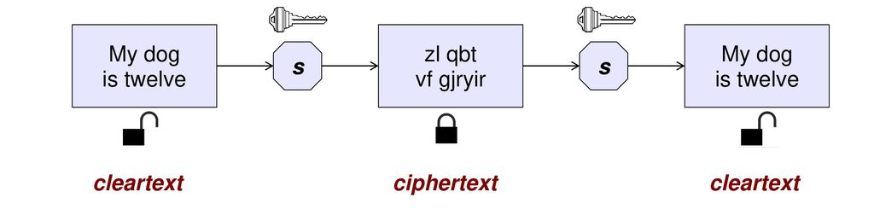
Recap - Encryption

Slide 6
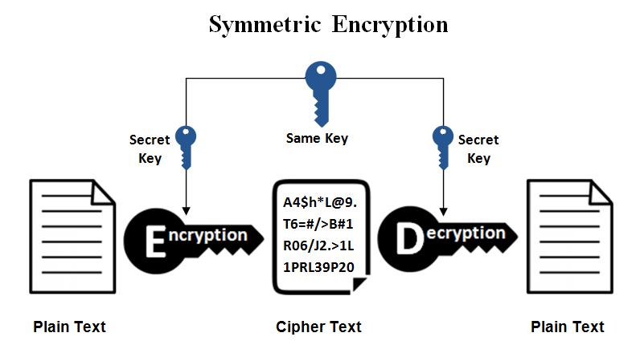
Recap - Encryption
Symmetric
Private/shared key algorithms
DES
3DES
AES

Slide 7
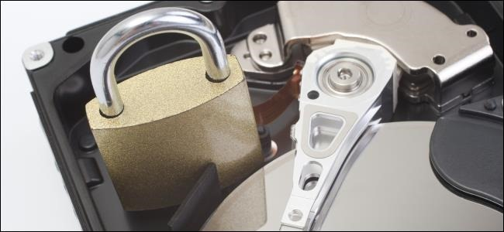
Recap - Encryption
Symmetric
Private/shared key algorithms
DES
3DES
AES
FAST!!

Slide 8
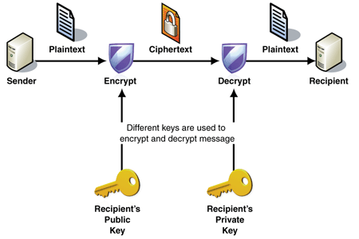
Recap - Asymmetric key exchange
SLOW!

Slide 9
Exercise 1/4
Open wireshark
Listen on the interface that is facing the world (probably WIFI)
Filter “ip.addr == 130.225.157.100 and ssl”
Visit https://esrl.dk
wget
firefox
chrome
Protocol should be TLSv1.2

Slide 10
TLS Protocol
Negotiate parameters
Client verifies server
Agree on master key

Slide 11
TLS - Client Hello
List of supported ciphers
Random key
Session ID
TLS extensions

Slide 12
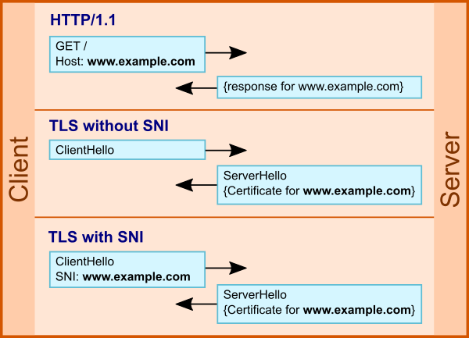
TLS - Client Hello
List of supported ciphers
Random key
Session ID
TLS extensions
SNI

Slide 13
TLS - Client Hello
List of supported ciphers
Random key
Session ID
TLS extensions
SNI

Slide 14
TLS - Client Hello
List of supported ciphers
Random key
Session ID
TLS extensions
SNI
Multiple domains with TLS on the same IP!
Consequence?
Notes:
Consequence = encrypted domains can be logged (only the domain)

Slide 15
TLS - Server Hello + ..
Server hello
Random key
Chosen cipher
SessionID
Certificate
Certificate contains public key <- important
Server key exchange
Parameters
Server hello done
Handshake done

Slide 16
TLS - Client key exchange + ..
Client key exchange
Parameters
Change cipher spec
Everything will now be encrypted
Encrypted Handshake Message
Verifies client knows how to encrypt

Slide 17
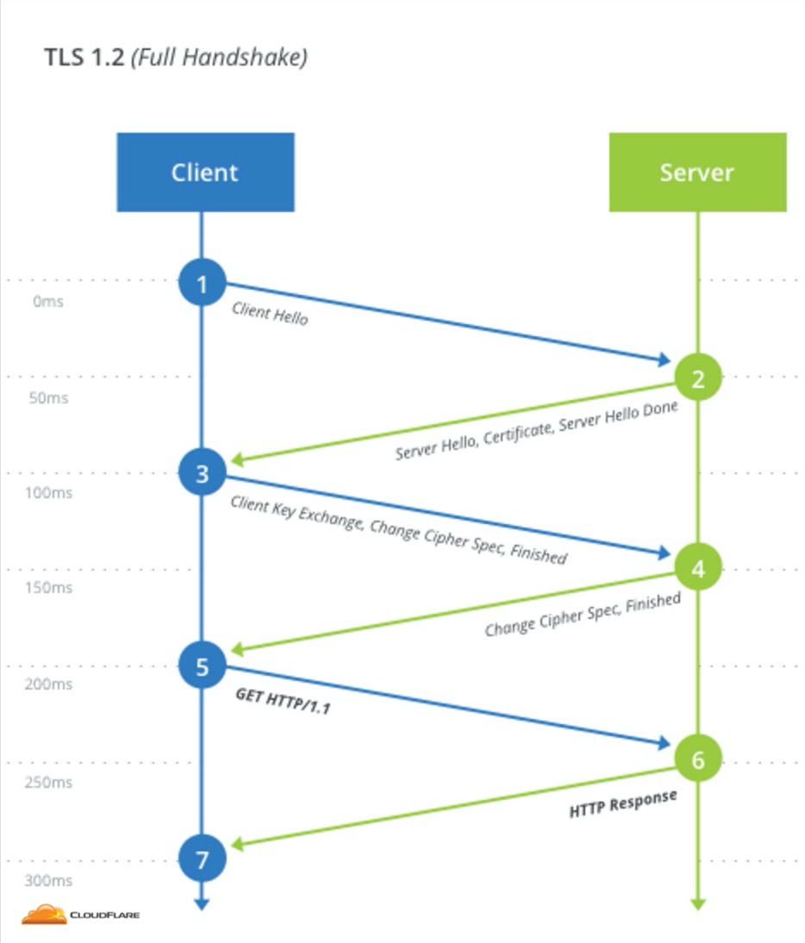
TLS - New session ticket + ..
New session ticket
Session
Change Cipher Spec
Everything will now be encrypted
Encrypted Handshake Message
Verifies server knows how to encrypt

Slide 18
Cipher suite
Key exchange algorithm
Encryption algorithm
Message Authentication Code (MAC) algorithm
Authentication algorithm

Slide 19
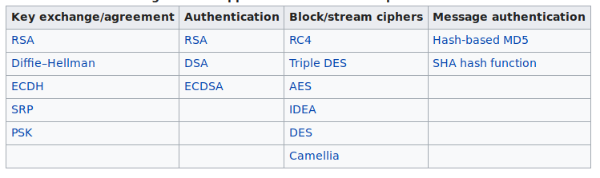
Cipher suite
Key exchange algorithm
Encryption algorithm
Message Authentication Code (MAC) algorithm
Authentication algorithm

Slide 20
Cipher suite
Key exchange algorithm
Encryption algorithm
Message Authentication Code (MAC) algorithm
Authentication algorithm

Slide 21
Cipher suite
Key exchange algorithm
Encryption algorithm
Message Authentication Code (MAC) algorithm
Authentication algorithm

Slide 22
Cipher suite
Key exchange algorithm
Encryption algorithm
Message Authentication Code (MAC) algorithm
Authentication algorithm

Slide 23
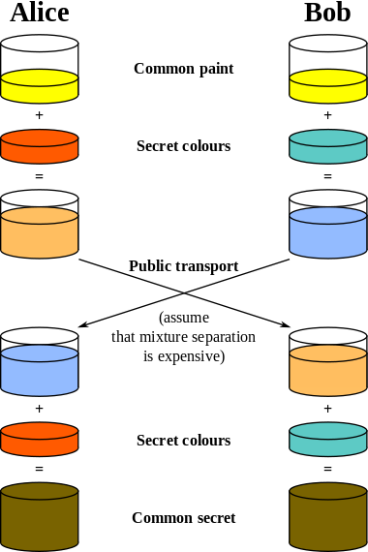
Key exchange algorithm - Diffie Hellman
How client and server calculates private key
that an evesdropper can’t see.
No trust

Slide 24
Key exchange algorithm - diffie hellman
How client and server calculates private key
that an evesdropper can’t see.
No trust

Slide 25
Key exchange algorithm - diffie hellman
How client and server calculates private key
that an evesdropper can’t see.
No trust

Slide 26
Key exchange algorithm - diffie hellman
How client and server calculates private key
that an evesdropper can’t see.
No trust

Slide 27
Key exchange algorithm - diffie hellman
How client and server calculates private key
that an evesdropper can’t see.
No trust

Slide 28
Key exchange algorithm - diffie hellman
How client and server calculates private key
that an evesdropper can’t see.
No trust
(Color is just for intuitive explanation)
pre_master_key
Notes:
Requires key to be exported from browser in order to see the data.

Slide 29
Key exchange algorithm - RSA
Client uses server’s public key to encrypt
Server uses its private key to decrypt
No forward secrecy
Notes:
no forward secrecy as same private key is used to decrypt master key

Slide 30
(pre)-Master-key
master_secret =

Slide 31
(pre)-Master-key
master_secret = PRF()

Slide 32
(pre)-Master-key
master_secret = PRF(pre_master_secret)

Slide 33
(pre)-Master-key
master_secret = PRF(pre_master_secret, "master secret")

Slide 34
(pre)-Master-key
master_secret = PRF(pre_master_secret, "master secret",ClientHello.random + ServerHello.random)
For symmetric encryption (fx. AES)
Master-secret depends on client and servers’ “randomness”

Slide 35
Exercise 2/4
In terminal, run export SSLKEYLOGFILE=/tmp/key
In same terminal, run firefox/chrome/chromium-browser
Capture in wireshark while visiting https://esrl.dk
Filter “ip.addr == 130.225.157.100 and ssl”
Edit -> Preferences -> Protocols -> ssl -> “(pre)-master-secret log filename”
Set that to /tmp/key
See decrypted content

Slide 36
Summarize
Encryption algorithm
DES
AES
Key exchange algorithm
RSA
DH
Message Authentication Code (MAC) algorithm
Authentication algorithm

Slide 37
Message Authentication Code(MAC)
Integrity
msg: Hello
MAC: da:4g:f3:dead
Server
H(Hello || key) = da:4g:f3:dead
Notes:
https://cardinalpeak.com/blog/the-difference-between-hmac-and-mac/
https://crypto.stackexchange.com/questions/6523/what-is-the-difference-between-mac-and-hmac

Slide 38
Message Authentication Code(MAC)
Integrity
msg: Hello
MAC: da:4g:f3:dead
Server
H(Hello || key) = da:4g:f3:dead
H(Hello || key) = da:4g:f3:dead
Notes:
https://cardinalpeak.com/blog/the-difference-between-hmac-and-mac/
https://crypto.stackexchange.com/questions/6523/what-is-the-difference-between-mac-and-hmac

Slide 39
Message Authentication Code(MAC)
Integrity
w
msg: Hello
MAC: da:4g:f3:dead
Server
H(Hello || key) = da:4g:f3:dead
H(Hellw|| key) = dk:34:da:beef
Notes:
https://cardinalpeak.com/blog/the-difference-between-hmac-and-mac/
https://crypto.stackexchange.com/questions/6523/what-is-the-difference-between-mac-and-hmac

Slide 40
Message Authentication Code(MAC)
Integrity
Authentication
Must be unforgeable under chosen-message attacks
msg: Send 10$ to ..
MAC: da:4g:f3:dead
msg: Hello
MAC: da:4g:f3:dead
Server
H(Send 10$ to ..|| key) = dk:34:da:beef
Notes:
https://cardinalpeak.com/blog/the-difference-between-hmac-and-mac/
https://crypto.stackexchange.com/questions/6523/what-is-the-difference-between-mac-and-hmac

Slide 41
Message Authentication Code(MAC)
MAC = H(message || secret)
H = ?
Notes:
https://cardinalpeak.com/blog/the-difference-between-hmac-and-mac/
https://crypto.stackexchange.com/questions/6523/what-is-the-difference-between-mac-and-hmac

Slide 42
Hash-based Message Authentication Code(HMAC)
MAC = H(message || secret)
H = Hash
(H can be other functions than a hash)
Notes:
https://cardinalpeak.com/blog/the-difference-between-hmac-and-mac/
https://crypto.stackexchange.com/questions/6523/what-is-the-difference-between-mac-and-hmac

Slide 43
Hash-based Message Authentication Code(HMAC)
MAC = H(message || secret)
H = Hash
(H can be other functions than a hash)
HMAC-SHA256
HMAC-MD5
Notes:
https://cardinalpeak.com/blog/the-difference-between-hmac-and-mac/
https://crypto.stackexchange.com/questions/6523/what-is-the-difference-between-mac-and-hmac

Slide 44
Hash-based Message Authentication Code(HMAC)
MAC = H(message || secret)
H = Hash
(H can be other functions than a hash)
HMAC-SHA256
HMAC-MD5
H(message1) == H(message2)
Notes:
https://cardinalpeak.com/blog/the-difference-between-hmac-and-mac/
https://crypto.stackexchange.com/questions/6523/what-is-the-difference-between-mac-and-hmac

Slide 45
Hash-based Message Authentication Code(HMAC)
MAC = H(message || secret)
H = Hash
(H can be other functions than a hash)
HMAC-SHA256
HMAC-MD5
H(message1) == H(message2)
H(secret || message1) == H(secret || message2)
Notes:
https://cardinalpeak.com/blog/the-difference-between-hmac-and-mac/
https://crypto.stackexchange.com/questions/6523/what-is-the-difference-between-mac-and-hmac

Slide 46
Hash-based Message Authentication Code(HMAC)
MAC = H(message + secret)
H = Hash
(H can be other functions than a hash)
HMAC-SHA256
HMAC-MD5
H(message1) == H(message2)
H(secret || message1) == H(secret || message2)
HMAC = H(secret1 || H(secret2 || message))
Notes:
https://cardinalpeak.com/blog/the-difference-between-hmac-and-mac/
https://crypto.stackexchange.com/questions/6523/what-is-the-difference-between-mac-and-hmac

Slide 47
Summarize
Encryption algorithm
AES
RC4
Key exchange algorithm
RSA
DH
Message Authentication Code (MAC) algorithm
Integrity
Authentication
Authentication algorithm
RSA

Slide 48
Authentication
esrl.dk
esrl.dk

Slide 49
Authentication
esrl.dk
DNS injection
esrl.dk

Slide 50
Certificate
X.509

Slide 51
Certificate
X.509
Certificate
Version Number
Serial Number
Signature Algorithm ID
Issuer Name
Validity period
Not Before
Not After
Subject name
Subject Public Key Info
Public Key Algorithm
Subject Public Key
Issuer Unique Identifier (optional)
Subject Unique Identifier (optional)
Extensions (optional)
…
Certificate Signature Algorithm
Certificate Signature

Slide 52
Certificate example
Certificate: Data: Version: 3 (0x2) Serial Number: 04:00:00:00:00:01:15:4b:5a:c3:94 Signature Algorithm: sha1WithRSAEncryption Issuer: C=BE, O=GlobalSign nv-sa, OU=Root CA, CN=GlobalSign Root CA Validity Not Before: Sep 1 12:00:00 1998 GMT Not After : Jan 28 12:00:00 2028 GMT Subject: C=BE, O=GlobalSign nv-sa, OU=Root CA, CN=GlobalSign Root CA Subject Public Key Info: Public Key Algorithm: rsaEncryption Public-Key: (2048 bit) Modulus: 00:da:0e:e6:99:8d:ce:a3:e3:4f:8a:7e:fb:f1:8b: ... Exponent: 65537 (0x10001) X509v3 extensions: X509v3 Key Usage: critical Certificate Sign, CRL Sign X509v3 Basic Constraints: critical CA:TRUE X509v3 Subject Key Identifier: 60:7B:66:1A:45:0D:97:CA:89:50:2F:7D:04:CD:34:A8:FF:FC:FD:4B Signature Algorithm: sha1WithRSAEncryption d6:73:e7:7c:4f:76:d0:8d:bf:ec:ba:a2:be

Slide 53
Signing
h1 = H(cleartext)
h1 = hash = digest

Slide 54
Signing
h1 = H(cleartext)
signature = E(h1, private key)

Slide 55
Signing
h1 = H(cleartext)
signature = E(h1, private key)
M = signature || cleartext

Slide 56
Certificate-Signing-Request (CSR)
Wants to run https-server
Generates
key.priv
req.csr

Slide 57
Certificate-Signing-Request (CSR)
VeriSign
Sends req.csr
Wants to run https-server
Generates
key.priv
req.csr

Slide 58
Certificate-Signing-Request (CSR)
VeriSign
Verifies CSR
Sends req.csr
Wants to run https-server
Generates
key.priv
req.csr

Slide 59
Certificate-Signing-Request (CSR)
VeriSign
Verifies CSR
Sends req.csr
Wants to run https-server
Sends cert.pub
Generates
key.priv
req.csr

Slide 60
CSR
Certification request information
Name
CN (domain)
Contact information
Address
..
A signature algorithm identifier
SHA1
Digital signature
Ideas why ?
Notes:
signature in order to avoid the csv is being tampered with
Signed with requester’s private key

Slide 61
Certificate Authority
RootCA
Keep the private key safe!
RootCA

Slide 62
Certificate Authority
RootCA
Keep the private key safe!
RootCA
Signing cert

Slide 63
Certificate Authority
RootCA
Keep the private key safe!
RootCA
Signing cert
Server cert
Client cert

Slide 64
Certificate Authority
RootCA
Keep the private key safe!
RootCA
Signing cert
Server cert
Client cert
https
smtps
leon-pc
thor-pc
john-pc

Slide 65
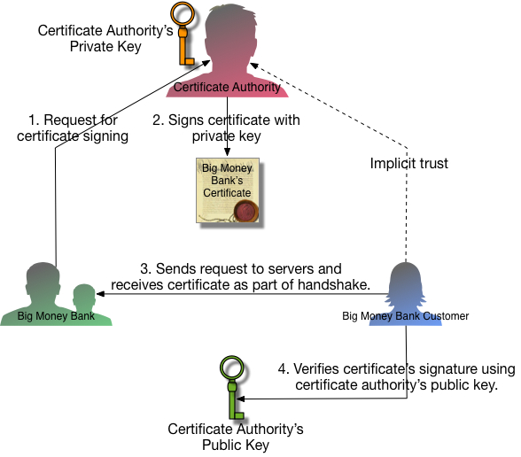
Trust

Slide 66
Certificate-Signing-Request (CSR)
VeriSign
Verifies CSR
Sends req.csr
Wants to run https-server
Sends cert.pub
Generates
key.priv
req.csr

Slide 67
Certificate-Signing-Request (CSR)
VeriSign
Verifies CSR
Sends req.csr
Wants to run https-server
Sends cert.pub
Wants to visit https server
Sends cert.pub
Generates
key.priv
req.csr

Slide 68
Certificate-Signing-Request (CSR)
rootca.pub
VeriSign
Verifies CSR
Sends req.csr
Wants to run https-server
Sends cert.pub
Wants to visit https server
Sends cert.pub
Generates
key.priv
req.csr

Slide 69
Certificate-Signing-Request (CSR)
rootca.pub (installed in browser)
VeriSign
Verifies CSR
Sends req.csr
Wants to run https-server
Sends cert.pub
Wants to visit https server
Sends cert.pub
Generates
key.priv
req.csr

Slide 70
Certificate-Signing-Request (CSR)
rootca.pub (installed in browser)
VeriSign
Verifies CSR
Sends req.csr
Wants to run https-server
Sends cert.pub
Wants to visit https server
Sends cert.pub
Generates
key.priv
req.csr
digest = D(cert.signature, rootca.publickey)
H(cert.pub) == digest

Slide 71
Summarize
Encryption algorithm
AES
RC4
Key exchange algorithm
RSA
DH
Message Authentication Code (MAC) algorithm
Integrity
Authentication
Authentication algorithm
RSA
Break ?

Slide 72

Random

Slide 73
Mitmproxy
https://esrl.dk
mitmproxy
https://esrl.dk
esrl.dk

Slide 74
Mitmproxy
200 OK
mitmproxy
200 OK
esrl.dk

Slide 75
Exercise 3/4
sudo pip3 install mitmproxy
sudo iptables -t nat -A OUTPUT -p tcp -m owner ! --uid-owner root --dport 443 -j REDIRECT --to-port 8080
Install rootCA (~/mitmproxy/mitmproxy-ca-cert.pem) in browser
Run mitmproxy
sudo mitmproxy --mode transparent --showhost
Filter request or reply
i = interception filter fx. “esrl.dk” without “
enter to select message
e = edit message
a = allow flow
Visit https://esrl.dk

Slide 76
Exercise 4/4
Generate keypair as rootCA
openssl req -x509 -sha256 -nodes -days 365 -newkey rsa:4096 -keyout rootca.key -out rootca.crt
(don’t leave questions empty)
Generate new keypair for https
openssl req -out https-server.csr -new -newkey rsa:4096 -nodes -keyout https-server.key
(CN = hostname of PC running https-server)
Sign https-certificate with rootCA
openssl x509 -req -in https-server.csr -CAkey rootca.key -CA rootca.crt -days 10 -set_serial 1 -sha512 -out https-server.crt
cat https-server.crt https-server.key > server.includesprivatekey.pem
Run https-server using socat and openssl-listen:
socat openssl-listen:1443,verify=0,reuseaddr,cert=server.includesprivatekey.pem,fork system:'date'
Install rootca.crt in browser
openssl cheatsheet:
https://gist.github.com/webtobesocial/5313b0d7abc25e06c2d78f8b767d4bc3

